Slide 1

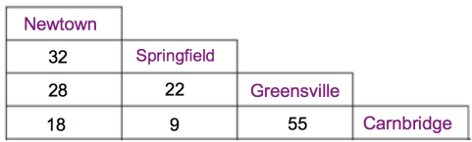
Subtopic N2.14 – Solve Problems involving Tables and Timetables
LEARNING OUTCOME: To recognise the place value of any number in an integer up to one billion
Objectives:
To be able to read and interpret different kinds of tables of information
To convert between hours and minutes, and different
To solve problems involving time and timetables
Keywords:
Hours
Minutes
Distance
Introduction – Read and annotate:
In this topic, you will learn how to add and subtract in the context of distance charts, time and
timetables. You will also practise converting between 12-hour and 24-hour clock formats, which is
important for reading transport schedules accurately. These skills are useful in real-world situations,
such as working out journey times, calculating time differences, and interpreting travel or activity
schedules
Definition
AM stands for ante meridiem which translates to before noon (12 o clock midday).
PM stands for post meridiem which translates to after noon (12 o clock midday).
Characteristics
Used in a 12 hour clock to distinguish between morning or afternoon.
Does not have leading zeros in the hour part.
e.g. 09:00 would be written as 9:00 am
00:45 would be 12 :45 am.
Examples
AM and PM
Non - Examples
12:14 am
10:02 pm
4:02 pm
04:02
12:34
17:15
12.14 am
4.02 am
09.73
15:00
22:15
Distance charts
The table shows the distance in km between four towns.
Example 1 - I do…
Example 2 – We do…
Example 3 – You do…
Steps | What is the distance between Newton and Greensville? | Which towns are 55km apart? | What is the distance between Springfield and Carnbridge?
Identify the correct place in the table
Greensville
and
Carnbridge
9 km
28 km

Slide 2
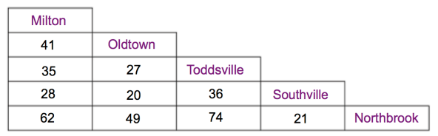
Independent Practice
1. The table shows the distance in km between five towns. Answer the questions below.
a) Write down the distance between Milton and Toddsville
b) Write down the distance between Milton and Southville
c) Write down the distance between Oldtown and Southville
d) Which towns are 27km apart?
e) Which towns are 62km apart?
f) Which towns are furthest apart?
g) Which towns are closest together?
h) James travels from his home in Milton to visit his mother in Oldtown. James then meets a friend in Southville before he returns home. How far did James travel?
i) Elliott travels from his home in Oldtown to visit his friend in Toddsville. He then goes shopping in Milton before returning home. How far did Elliott travel?
j) Marjorie travels from her home in Toddsville to a restaurant in Northbrook. She then goes to see a friend in Oldtown before returning home. How far did Marjorie travel?
35 km
28 km
20 km
Oldtown and Toddsville
Milton and Northbrook
Toddsville and Northbrook
Oldtown and Southville
89 km
103 km
150 km

Slide 3
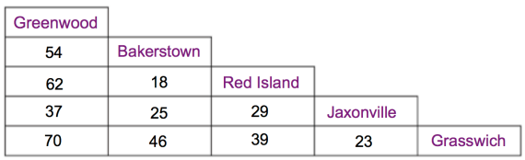
Independent Practice
2. The table shows the distance in km between five towns. Answer the questions below.
a) Write down the distance between Bakerstown and Jaxonville
b) Write down the distance between Red Island and Greenwood
c) Write down the distance between Grasswich and Bakerstown
d) Which towns are 25km apart?
e) Which towns are 39km apart?
f) Which towns are furthest apart?
g) Which towns are closest together?
h) Elsa lives in Jaxonvile but goes to work in Bakerstown. She travels to and from work 5 times a week. How far does she travel in a week?
i) Anna lives in Bakerstown but goes to work in Red Island. She travels to and from work 3 times a week. She goes shopping from home to Grasswich once a week. How far does she travel in a week?
j) Kristoff lives in Greenwood but goes to work in Jaxonville. He travels to and from work 4 times a week. He also goes from home to Red Island to see a friend once a week and goes shopping to Bakerstown from home once a week. How far does he travel in a week?
25 km
62 km
46 km
Bakerstown and Jaxonville
Red Island and Grasswich
Greenwood and Grasswich
Bakerstown and Red Island
250 km
200 km
528 km

Slide 4
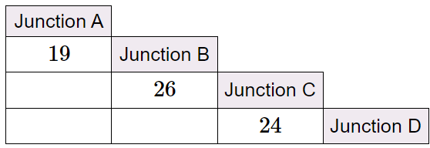
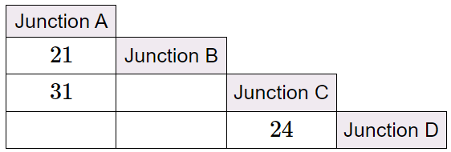
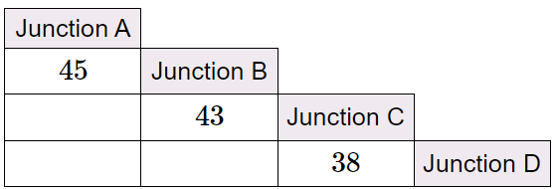
Junction charts
The tables below show the distances between junctions on a motorway.
Junction A
Junction B
Junction C
Junction D
Fill in the blanks in the distance chart
Example 4- I do…
45
69
50
Example 5 – We do…
10
55
34
Example 6 – You do…
88
126
81

Slide 5
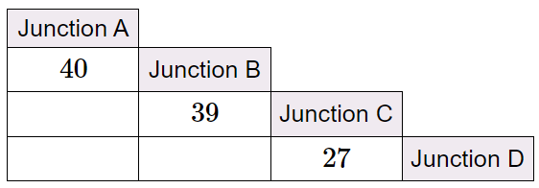
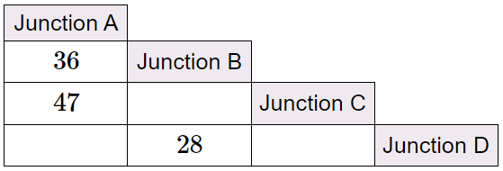
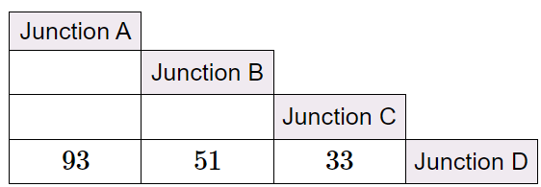
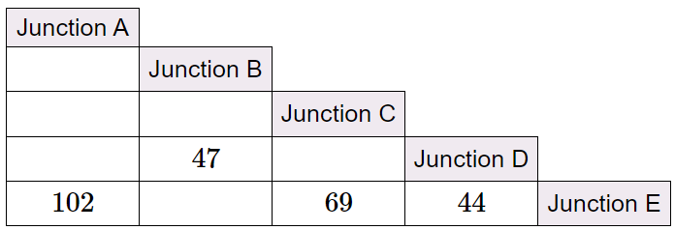
Independent Practice
The tables below show the distances between junctions on a motorway.
Junction A
Junction B
Junction C
Junction D
3. Fill in the blanks in the distance charts
a)
79
106
66
b)
11
64
17
c)
42
60
18
d)
11
33
22
58
25
91

Slide 6
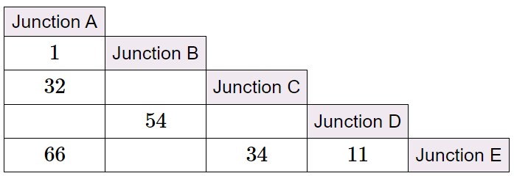
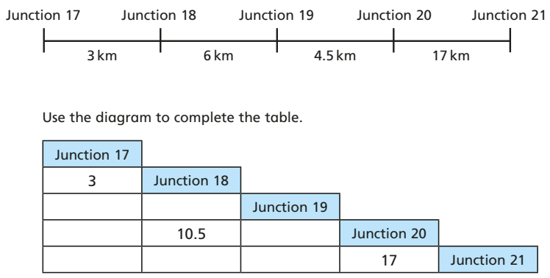



e)
31
55
23
65
f) The diagram shows the distance between some of the junctions on the M1 motorway. Use the diagram to complete the table.
9
6
13.5
4.5
30.5
27.5
21.5
Time conversions - hours to minutes
Example 7 - I do…
Example 8 – We do…
Example 9 – You do…
Steps | How many minutes in 2 hours 15 minutes? | How many minutes in 3 hours 10 minutes? | How many minutes in 2 hours 25 minutes
1) Count up in 60’s for each hour
2) Add the remaining minutes
Independent Practice
4. Write down these times in minutes:
a) 1 hour 5 minutes
b) 1 hour 10 minutes
c) 1 hour 11 minutes
d) 1 hour 27 minutes
65 minutes
70 minutes
71 minutes
87 minutes
e) 2 hours
f) 2 hours 20 minutes
g) 2 hours 59 minutes
h) 3 hours
120 minutes
140 minutes
179 minutes
180 minutes

Slide 7












i) 5 hours 5 minutes
j) 10 hours
k) 0 hours 48 minutes
l) 2 hours 27 minutes
305 minutes
600 minutes
48 minutes
147 minutes
m) Half an hour
p) A quarter of an hour
30 minutes
90 minutes
150 minutes
15 minutes
45 minutes
75 minutes
135 minutes
225 minutes
Time conversions - minutes to hours
Example 10 - I do…
Example 11 – We do…
Example 12 – You do…
Steps | How many hours and minutes in 125 minutes? | How many hours and minutes in 192 minutes? | How many hours and minutes in 235 minutes?
1) Count up in 60’s for each hour
2) Add the remaining minutes
2 hours 5 minutes
3 hours 12 minutes
3 hours 55 minutes
Independent Practice
5. Write down these times in hours and minutes
a) 60 minutes
b) 63 minutes
c) 73 minutes
d) 100 minutes
1 hour
1 hour 3 minutes
1 hour 13 minutes
1 hour 40 minutes
e) 119 minutes
f) 120 minutes
g) 150 minutes
i) 200 minutes
1 hour 59 minutes
2 hours
2 hours 30 minutes
3 hours 20 minutes
k) 27 minutes
l) 61 minutes
m) 600 minutes
n) 650 minutes
27 minutes
1 hour 1 min
10 hours
10 hours 50 minutes
p) 1 day
q) 1 day 2 hours
24 hours
26 hours
1 hour 30 minutes
2 hours 30 minutes
3 hours
3 hours 12 minutes
2 hours 15 minutes
3 hours 45 minutes

Slide 8









Time conversions 12 hour to 24 hour
Example 13 - I do…
Example 14 – We do…
Example 15 – You do…
Steps
12.00 am -1.00 am is equivalent to 00:00 to 01:00 | The time is 9:15 pm What time is this on a 24-hour clock? The time is 12:15 am What is the time on a 24-hour clock? The time is 9:23 am What is the time on a 24-hour clock? | The time is 7:25 pm What time is this on a 24-hour clock? The time is 12:28 am What is the time on a 24-hour clock? The time is 5:21 am What is the time on a 24-hour clock? | The time is 3:36 pm What time is this on a 24-hour clock? The time is 12:45 am What is the time on a 24-hour clock? The time is 3:17 am What is the time on a 24-hour clock?
1.00am to 1.00pm is equivalent to 01:00 to 13:00
From 1.00pm, add 12 to the value up to midnight
Independent Practice
6. Change these times to equivalent 24-hour times
a) 12:00 am
b) 12:06 am
c) 12:42 am
d) 1:00 am
00:00
00:06
00:42
01:00
e) 9:42 am
f) 5:17 am
g) 12:23 pm
h) 1:00 pm
09:42
05:17
12:23
13:00
i) 1:23 pm
j) 9:45 pm
k) 8:47 pm
l) 8:47 am
13:23
21:45
20:47
08:47
m) Midnight
n) Noon (midday)
o) Quarter to 6 in the morning
00:00
12:00
05:455
p) Quarter to 6 in the afternoon
q) Quarter to midnight
r) Quarter past midnight
17:45
23:45
00:15

Slide 9
Time conversions 24 hour to 12 hour
Example 16 - I do…
Example 17 – We do…
Example 18– You do…
Steps | The time is 09:15 What time is this on a 12 hour clock? | The time is 13:15 What is the time on a 12 hour clock? | The time is 14:24 What is the time on a 12 hour clock?
12.00 am -1.00 am is equivalent to 00:00 to 01:00
1.00am to 1.00pm is equivalent to 01:00 to 13:00
After 1.00pm add 12 to the value up to midnight
9:15 am
1:15 pm
2:24 pm
Independent Practice
7. Change these times to a 12-hour clock. Remember to include AM or PM.
a) 00:00
b) 00:59
c) 01:00
d) 07:42
12:00 am
12:59 am
1:00 am
7:42 am
f) 11:59
g) 12:00
h) 12:23
i) 13:13
11:59 am
12:00 pm
12:23 pm
1:13 pm
k) 17:42
l) 03:42
m) 03:13
n) 23:13
5:42 pm
3:42 am
3:13 am
11:13 pm
p) Midnight
q) Noon (midday)
r) Quarter to 1 in the morning
12:00 am
12:00pm
12:45 am
s) Quarter past 1 in the morning
t) Quarter to midnight
u) Quarter past midnight
1:15 am
11:45 pm
12:15 am

Slide 10
Calculating with time - adding time on
Example 19 - I do…
Example 20 – We do…
Example 21 – You do…
Steps | What time is it 1 hour 20 minutes after 08:45? | What time is it 1 hour 30 minutes after 08:45? | What time is it 1 hour 30 minutes after 08:50?
1) Work out minutes to the next hour
2) Work out the hours and extra minutes after
10:05
Or 10:05 am
10:15
Or 10:15 am
10:20
Or 10:20 am
Independent Practice
8. Work out:
a) 1 hour after 08:55
b) 1 hour 10 minutes after 08:55
c) 70 minutes after 08:55
09:55
Or 9:55 am
10:05
Or 10:05 am
10:05
Or 10:05 am
d) 100 minutes after 08:55
e) 2 hours 2 minutes after 09:59
f) 2 hours 2 minutes after 21:59
10:35
Or 10:35 am
12:01
Or 12:01 pm
00:01
Or 12:01 am
g) 3 hour 30 minutes after 3:50pm
h) 3 hours 30 minutes after
3.28pm
i) 3 hours 30 minutes after
11:40pm
19:20
Or 7:20 pm
18:58
Or 6:58 pm
03:10
Or 3:10 am
j)24 hours after 06:17
k) 25 hours after 06:17
l) 23 hours after 06:17
06:17
Or 6:17 am
07:17
Or 7:17 am
05:17
Or 5:17 am
m) 1 day 12 hours after 06:17
12 hours 47 minutes after
06:17
o) 48 hours after 3.15pm
18:17
Or 6:17 pm
19:04
Or 7:04 pm
15:15
Or 3:15 pm

Slide 11
Calculating with time - taking time off
Example 22 - I do…
Example 23 – We do…
Example 24 – You do…
Steps | What time is it 1 hour 20 minutes before 08:45? | What time is it 1 hour 20 minutes before 08:15? | What time is it 1 hour 30 minutes before 08:25?
1) Work out minutes to the next hour
2) Work out the hours and extra minutes after
07:25
Or 7:25 am
06:55
Or 6:55 am
06:55
Or 6:55 am
Independent Practice
9. Work out:
a) 1 hour before 08:05
b) 1 hour 5 minutes before 08:05
c) 1 hour 6 minute before 08:05
07:05
Or 7:05 am
07:00
Or 7:00 am
06:59
Or 6:59 am
d) 67 minutes before 08:05
e) 100 minutes before 08:05
f) 2 hours 2 minutes before 13:01
06:58
Or 6:58 am
06:25
Or 6:25 am
10:59
Or 10:59 am
g) 2 hours 2 minutes before
3.01pm
h) 2 hours 2 minutes before
1:01am
i) 2hours 2 minutes before 01:01
12:59
Or 12:59 pm
22:59
Or 10:59 pm
22:59
Or 10:59 pm
j) 2 hours 12 minutes before 14:23
k) 2 hours 12 minutes before
14:06
l) 12 hours 12 minutes before
14:06
12:11
Or 12:11 pm
11:54
11:54 am
01:54
1:54 am
m) 12 hours 12 minutes before 13:06
n) 12 hours 12 minutes before 12:06
o) 12 hours 12 minutes before 11:06
00:54
12:54 am
23:54
11:54 pm
22:54
10:54 pm
p) 24 hours before 15:17
q) 23 hours before 15:17
r) 25 hours before 15:17
15:17
3:17 pm
16:17
4:17 pm
14:17
2:17 pm
‹#›

Slide 12




s) 24 hours 18 minutes before 15:17
t) 23 hours 18 minutes before 15:17
u) 48 hours before 15:17
14:59
2:59 pm
15:59
3:59 pm
15:17
3:17 pm
Calculating time in between no context
Example 25 - I do…
Example 26 – We do…
Example 27 – You do…
Steps | How many minutes between 50 minutes and 1 hour 23 minutes? |  | How many minutes between 47 minutes and 1 hour 25 minutes?
Convert both times into minutes.
Find the difference.
33 minutes
28 minutes
38 minutes
Independent Practice
10. Calculate the difference between the times
1 hour 10 minutes and
50 minutes
b) 1 hour 5 minutes and 30 minutes
c) 1 hour 6 minutes and 47 minutes
20 minutes
35 minutes
19 minutes
d) 2 hours 6 minutes and 47 minutes
e) 3 hours 6 minutes and 47 minutes
f) 100 minutes and 1 hour 30 minutes
79 minutes
139 minutes
10 minutes
g) 3 hours 24 minutes and 2 hours 20 minutes
h) 3 hours 24 minutes and 2 hours 30 minutes
i) 2 hours 2 minutes and 1 hour 58 minutes
64 minutes
54 minutes
4 minutes
j) 2 hours and 135 minutes
k) Half an hour and 720 minutes
15 minutes
690 minutes
15 minutes
45 minutes
95 minutes
75 minutes
‹#›

Slide 13
Calculating time in between 12 and 24 hour times
Example 28 - I do…
Example 29 – We do…
Example 30 – You do…
Steps | How long is it between 08:45 and 10:20? | How long is it between 08:35 and 10:20? | How long is it between 08:43 and 10:20?
1) Work out minutes to the next hour
2) Work out the hours and extra minutes after
1 hour 35 minutes
95 minutes
1 hour 45 minutes
105 minutes
1 hour 37 minutes
97 minutes
Independent Practice
11. Calculate the difference between the times:
a) 10:17 and 10:45
b) 09:06 and 9:35
c) 15:54 and 15:12
28 minutes
29 minutes
42 minutes
d) 09:17 and 10:17
e) 09:17 and 10:18
f) 09:17 and 10:16
1 hour
Or 60 minutes
1 hour 1 min
Or 61 minutes
59 minutes
g) 09:17 and 10:00
h) 09:17 and 10:05
i) 03:28 and 15:28
43 minutes
48 minutes
12 hours
Or 720 minutes
j) 03:28 and 15:27
k) 3 am and 4 pm
l) 3.27am and 4.37pm
11 hours 59 minutes
Or 719 minutes
13 hours
Or 780 minutes
13 hours 10 minutes
Or 790 minutes
m) 03:27am and 4:17pm
n) Monday 4 pm and Tuesday
1am
o) Monday 4pm and Tuesday 2pm
12 hours 50 minutes
Or 770 minutes
9 hours
Or 540 minutes
22 hours
Or 1320 minutes

Slide 14
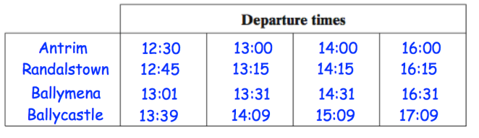
Using timetables
Example 31 - I do…
Here is part of a train timetable
a) The train that leaves Randalstown at 13:15 arrives at what time at Ballycastle?
14:09
b) How many minutes does the 13:15 train from Randalstown take to get to Ballycastle?
54 minutes
c) Jenny wants to visit Ballymena. She must arrive before 13:45, what time is the latest train she can use from Antrim?
13:00
Example 32 – We do…
Here is part of a train timetable
a) The train that leaves Ballymena at 16:31 arrives at what time at Ballycastle?
17:09
b) How many minutes does the 16:00 train from Antrim take to get to Ballycastle?
1 hour 9 minutes or 69 minutes
c) Jenny wants to visit Ballycastle. She must arrive before 13:45, what time is the latest train she can use from Antrim?
12:30
‹#›

Slide 15
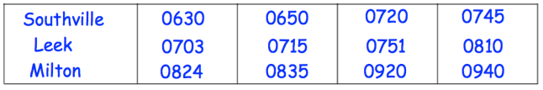
Example 33 – You do…
Here is part of a train timetable
a) The train that leaves Antrim at 14:00 arrives at what time at Ballycastle?
15:09
b) How many minutes does the 13:15 train from Randalstown take to get to Ballymena?
16 minutes
c) Jenny wants to visit Ballycastle. She must arrive before 16:45, what time is the latest train she can use from Antrim?
14:00
Independent Practice
12. Interpret the information in the table
Here is part of a train timetable
a)i) What time does the 0715 train from Leek arrive at Milton?
0835
a)ii) What time does the 0745 train from Southville arrive at Milton?
0940
a)iii) How many minutes does the 0715 train from Leek take to arrive at Milton?
80 minutes
a)iv) How many minutes does the 0630 train from Southville take to arrive at Milton?
114 minutes
‹#›

Slide 16
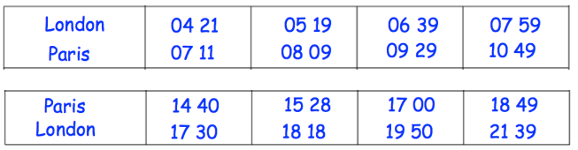
a)v) Jenny wakes up at 6:15 and takes 20 minutes to get to the station at Southville.
She catches the next train to Leek. At what time does she arrive?
07:15
a)vi) John wants the shortest journey time from Southville to Leek. What time should he get on the train?
06:50 or 07:45
a)vii) Ali wants the longest journey time from Southville to Milton. What time should he get on the train?
07:20
Independent Practice
Key
GMT = Greenwich mean time
(no need for time zone calculations)
b) The timetable shows the times of trains (GMT) between London and Paris
b)i) What time does the 0519 train from London arrive at Paris?
08:09
b)ii) What time does the 1528 train from Paris arrive at London?
18:18
b)iii) The train departing at 1440 is heading towards which city?
London
b)iv) How many minutes does the 0421 train from London take to get to Paris?
170 minutes
‹#›

Slide 17
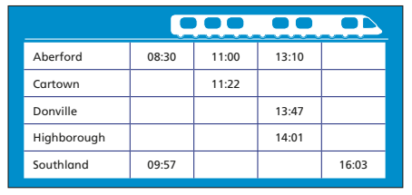
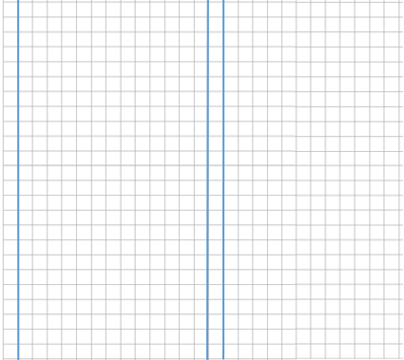
b)v) Gemma wakes up at 6:15 and takes 20 minutes to get to the station at London.
She catches the next train to Paris. She spends exactly 6 hours in Paris. Is she able to catch the
1528 train back to London?
No
b)vi) Insert the correct symbol, <, > or =, to make the following statement true:
The time taken for the 0519 train to Paris The time taken for the 1700 train back to London?
=
c) In this timetable, all the trains stop at every stations and the times taken between stations do not change.
Fill in the missing information
14:36
08:52
13:32
14:58
09:07
11:37
15:13
09:21
11:51
15:27
12:27
13:37
‹#›

